Slide 1
Today’s Steps
Base your book on a theme relevant and important to you.
Activate 2 more pages in your book by Visually Journaling your thoughts.
Write something- a poem, or story, intertwined with artistic elements that are supportive to your theme.
Complete a Self Assessment & a Peer Assessment
Then attach it into your book behind the pages you worked today.
Then place you book on the drying rack and begin cleaning up your area.

Slide 2
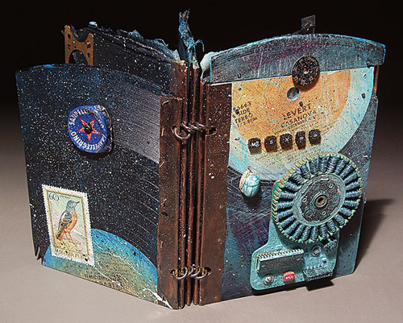
Artist Books
Inspiration for your * Altered Book

Slide 3
What Is an Artist Book?
"Artist books" don't look like most volumes found in a library.
They are art objects in the form of books. As with painting or sculpture, much of the "story" in these books is visual.

Slide 4
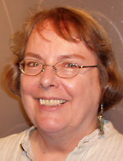
JUDITH HOFFMAN
I make artist's books using jewelry techniques and collage, and metaphorical tools, like Dream Focusing Device.
I was mostly thinking about sound, music, and the feelings music can convey.

Slide 5
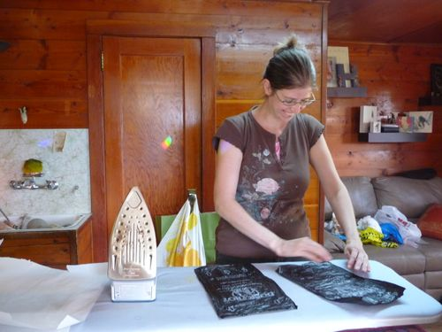
Debra T. Williams
A Story About You This accordion file book tells the story of how a genetic condition passes through a family

Slide 6
Women of the Book: Jewish Artists
From personal narrative (including family relationships), ritual and liturgy, the Holocaust and history, literature and myth, the books in the exhibition demonstrate how Jewish women artists utilize the book form to equalize their position within Judaism

Slide 7
Wooden Book Blocks. Artist: Leanne Shapton The Tiny Book of Birds. Artist: Geninne Cassette Tape Book. Artist: Heather LG Bella Mini Recycle Bin Books. Artist: Erin Zamarzla

Slide 8
What Is an Artist Book?
Words may be used to reinforce a message, but they are not always essential to the book's meaning.

Slide 9
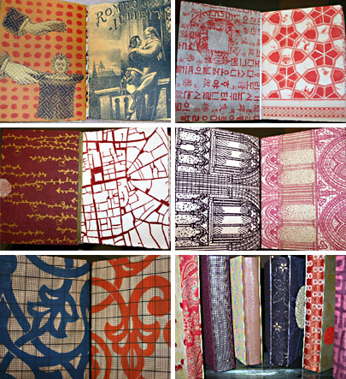
Book Artist Alison Kurke

Slide 10
What Is an Artist Book?
An idea may be illustrated in the book's shape or binding, in the materials used, or in the artist's choice of images.

Slide 11
Bonnie Thompson A Primer for Democracy
A Primer for Democracy was created in a class just before the 2004 presidential elections. The main theme — VOTE — is repeated and reinforced: CALL, FAX. Essentially, this alphabet book can be constructed, reconstructed, deconstructed in countless ways.

Slide 12
What might this book be about? How can you tell?

Slide 14
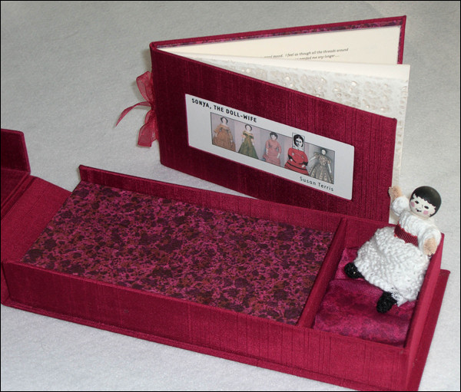

Slide 15
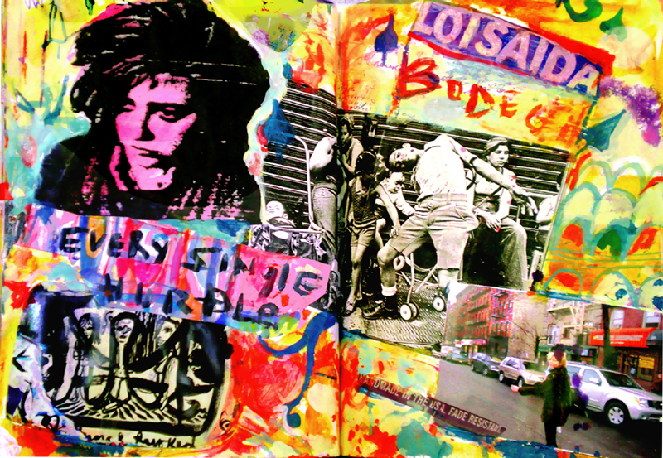

Slide 16
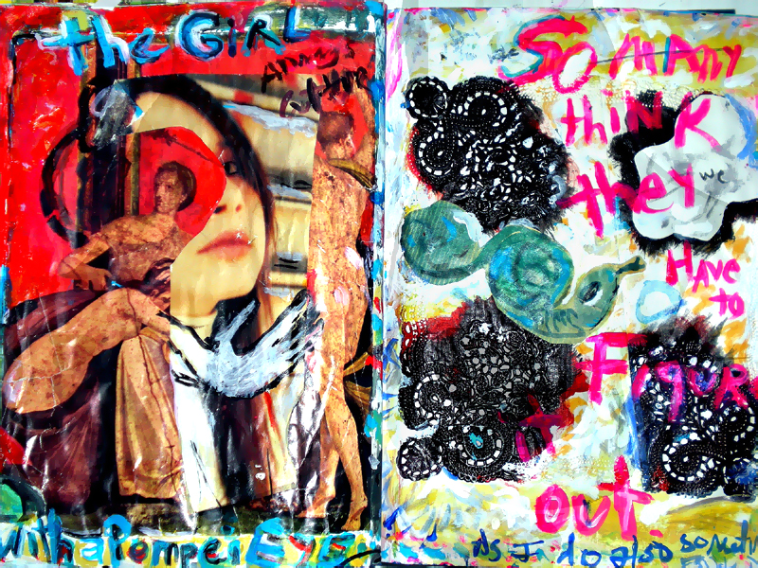

Slide 17
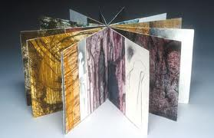
Is it about how you are changing as a person? Transitioning into High School?
Will it Express how you feel about a certain issue that you care about?
Will it show who you want to be in 5 years?
What will your book be about?

Slide 18
MISSION 2
Activate 2 more pages in your book, use writing combined with artistic elements to show why you care about your chosen theme.

Slide 19
Today’s Steps
Base your book on a theme relevant and important to you.
Activate 2 more pages in your book by Visually Journaling your thoughts.
Write something- a poem, or story, intertwined with artistic elements that are supportive to your theme.
Complete a Self Assessment & a Peer Assessment
Then attach it into your book behind the pages you worked today.
Then place you book on the drying rack and begin cleaning up your area.

Slide 20
MISSION 1 Set the Backdrop
Keeping in mind your potential theme for your book..
Use the watercolor and/or gesso, to prime 2 spreads of your book (That means 4 pages total). These will be your backgrounds for later “Missions” about your topic.

